Slide 1
Are You Sure?
Franco Niccolucci

Slide 2
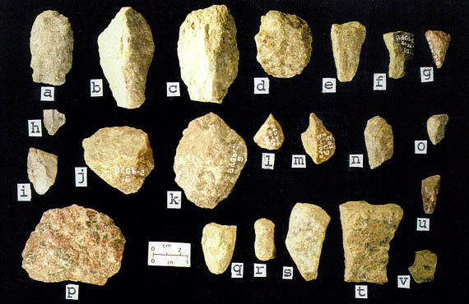
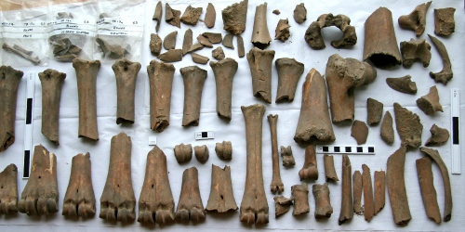
Some difficult cases
Classification of lithic artifacts (2001)
Classification of animal bones (2004)

Slide 3
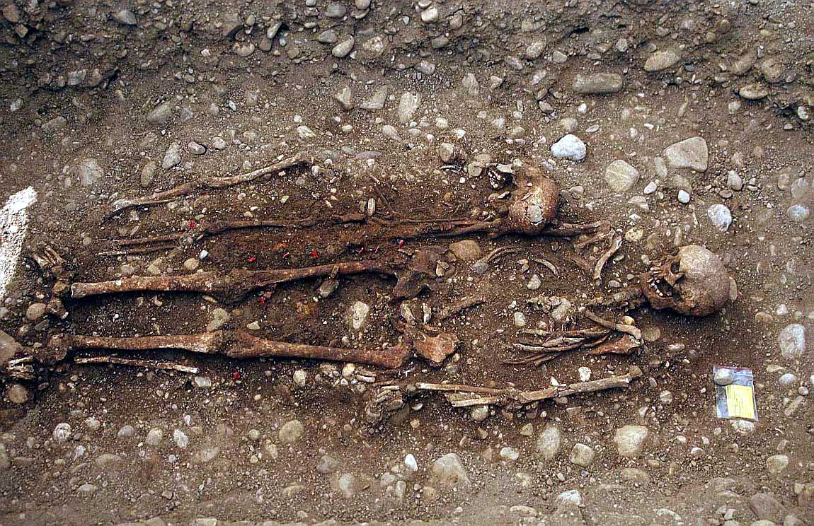
Some difficult cases
Estimate of the deceased age/sex in a necropolis (2001)

Slide 4
Virtual reconstructions
Attaching a confidence index to different virtual reconstruction (2004)

Slide 5
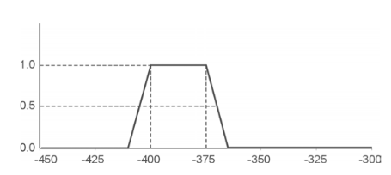
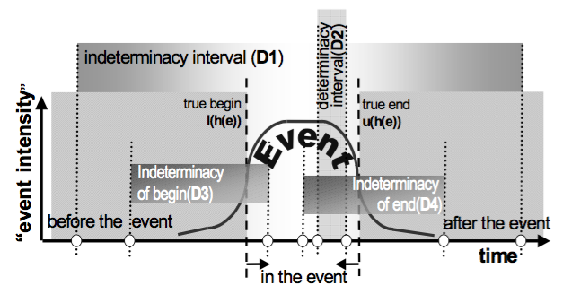
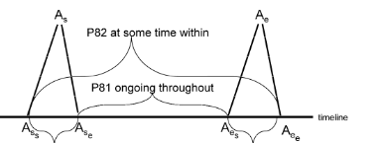
Linguistic issues with time periods
“First quarter of 4th century BC” (2001)
Supporting chronological reasoning (Doerr et al, 2004)
Event chronology (Holmen & Ore, 2009)
Matching time periods (Binding, 2010)
Time & chronology (2015)
A karstic river..

Slide 6
Back to classification
E17 Type Assignment
Lithic classification
Bones classification
Ceramics
Deceased sex
Deceased age class

Slide 7
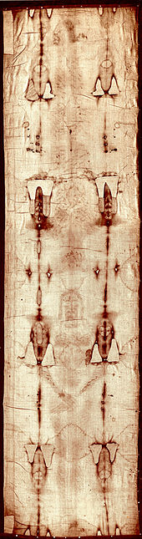
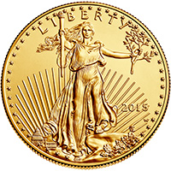

Other, miscellaneous
E14: The condition of this American Gold Eagle coin is “uncirculated” grade
E16: The C14 dating of the Turin Shroud is “Medieval Period”
E91: The person with CF NCCFNC48L22D612C is the same as VIAF ID 258811; this is also the author mentioned (with a mistyped name) in the authors’ list of CAA2000 & CAA2001

Slide 8
Definition of fuzzy entity
Given a set A (the “values”) a fuzzy entity is the couple formed by a variable X having values x in A, and by a function f_{X} from A to [0,1], so that to any instance x of X it is associated a number f_{X}(x) in [0, 1]. This number may be considered as the reliability of x.
x₂
f_{X}
x₁
1
A
x₃
0

Slide 9
Examples
A fuzzy label
  “Sex”
A fuzzy number
  “Young”
Label | Fuzzy value
Male | 0.7
Female | 0.5
1
16
18
25
28

Slide 10
Concept
Recording subjectivity in attribute assignments
R1: subclass of E16 Measurement
R2: subclass of E54 Dimension

Slide 11
Conclusion
Fuzziness may be a way to objectively record subjectivity in attribute assignments: “Hey, I am not so sure of this!”
This is cumbersome and often impractical
But it avoids false results when errors add up
It might become mandatory when using large datasets: how can I trust somebody else’s assertions? Was he sure?

